Slide 1

Mindful Drivers Detection and Data Visualization
Adi, Tim, David, Viru

Slide 2
Some data to understand why this is a problem
According to NHTSA, distracted driving had claimed almost 3,200 lives in 2017 alone.
The NHTSA estimated that 65% of near miss crashes are caused by drivers who are eating or drinking.
A study by scientists at Newfoundland's Memorial University found that reaction time can slow as much as 20% when someone is listening to loud music.

Slide 3
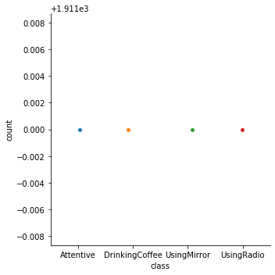
What is our solution?
Mindful Drivers is a machine learning model that trains on the thousands of samples of distracted drivers with the aim of using image recognition to accurately categorize the image into one of two categories with three more subcategories for distracted drivers.
The categories we used are:
Attentive
Distracted
Using Radio
Using Mirror
Drinking Coffee

Slide 4
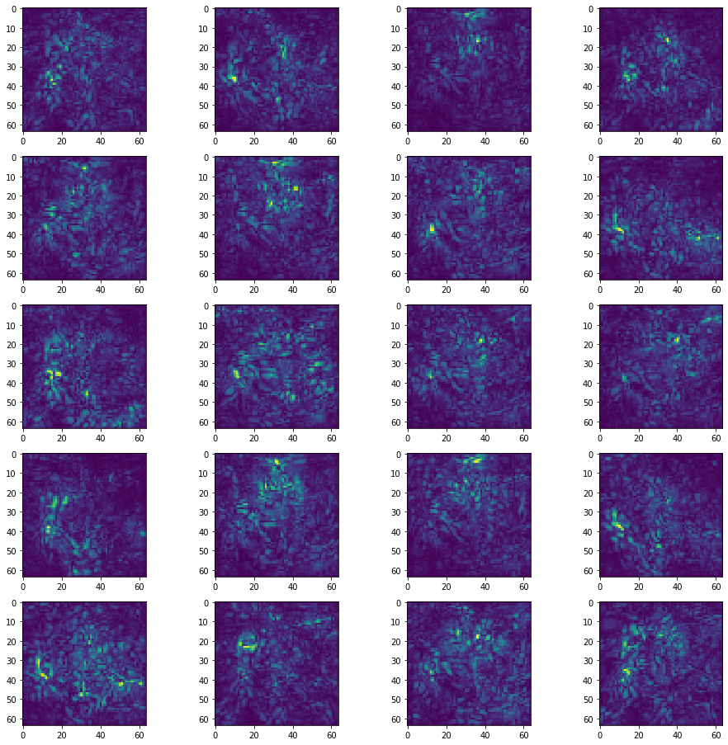
Where can this model be used?
This model can be used in an app which warns the user or triggers a safety mechanism based on how distracted the driver is.
The model can be used to analyze the kind of distracted driving prevalent in specific regions based on the number of times the model flagged that type of driving.
The model can also be used to analyze and collect data about how each distraction affects the driver’s response time.
The model can also be used in a traffic safety system to enforce safety.

Slide 5
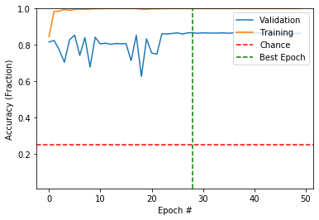
How It Was Built
The project utilizes a transfer learning model based on VGG16, which was trained on the Imagenet database.
Neuron layers are implemented to VGG16 in a Sequential model from Keras along with Dropout and GlobalAveragePooling2D to improve the efficiency of the model and prevent overfitting.
We fed in 64x64 images from the Inspirit AI Database as the x values and fed in the labels corresponding to the types of driving (Drinking Coffee, Using Mirror, Using Radio, and Attentive) as the y values.
The values were then classified as test and train data (75-25 split).

Slide 6
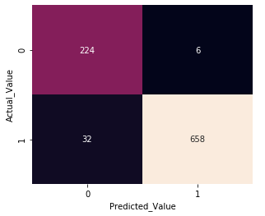
Stats
The model is trained and validated with a max categorical accuracy of 88% and max binary accuracy of 96%.
Some saliency and confusion maps were later drawn to provide insight into the model’s functionality and showcase the binary classification accuracy of the model.

Slide 7
Usage of Amazon Web Services
We ported the model to an AWS Sagemaker Notebook instance and initialized an API endpoint for the purpose of access to the model from different platforms.
As this is one of our first times utilizing cloud-based platforms (in our case, AWS), it was quite challenging to understand how to.

